Slide 1
Mesterséges intelligencia alapú képi biomarkerek az orvosi diagnosztikában
Dr. Kolossváry Márton József

Slide 2
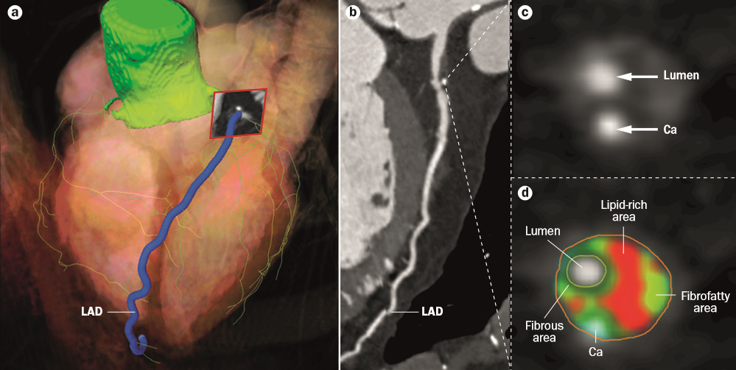
A radiológiai képek 3D-s adatkészletek

Slide 3
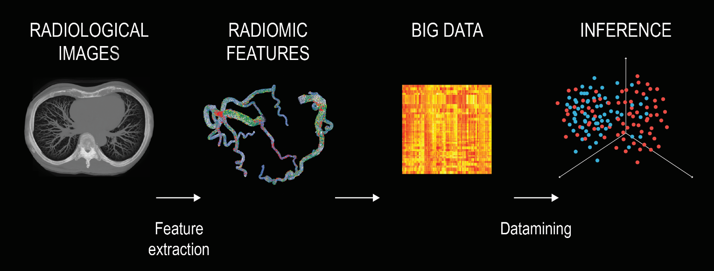
A radiológiai képekből nyert biomarkerek
Gépi tanulás

Slide 4
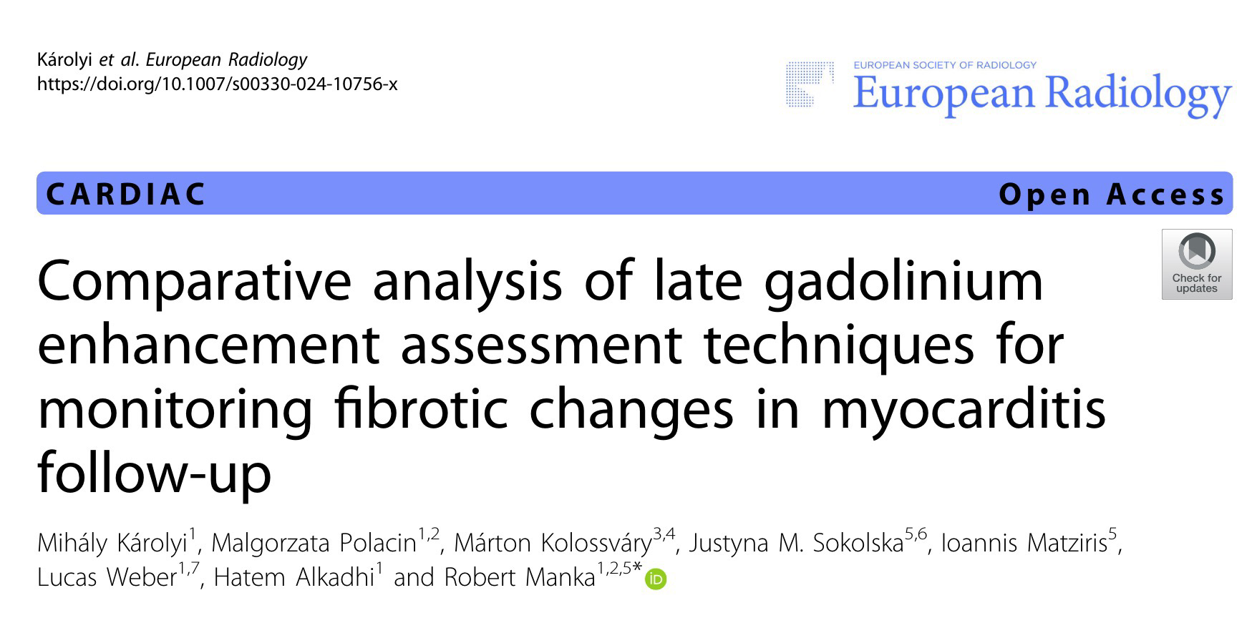

Slide 5
Myocariditis okozta fibrózis monitorozása MR segítségével
Objectives
To compare the repeatability and interrelation of various late gadolinium enhancement (LGE) assessment techniques for monitoring fibrotic changes in myocarditis follow-up.
Methods
LGE extent change between baseline and 3-month cardiovascular magnetic resonance (CMR) was compared in patients with acute myocarditis using the full width at half maximum (FWHM), gray-scale thresholds at 5 and 6 standard deviations (SD5 and SD6), visual assessment with threshold (VAT) and full manual (FM) techniques.

Slide 6
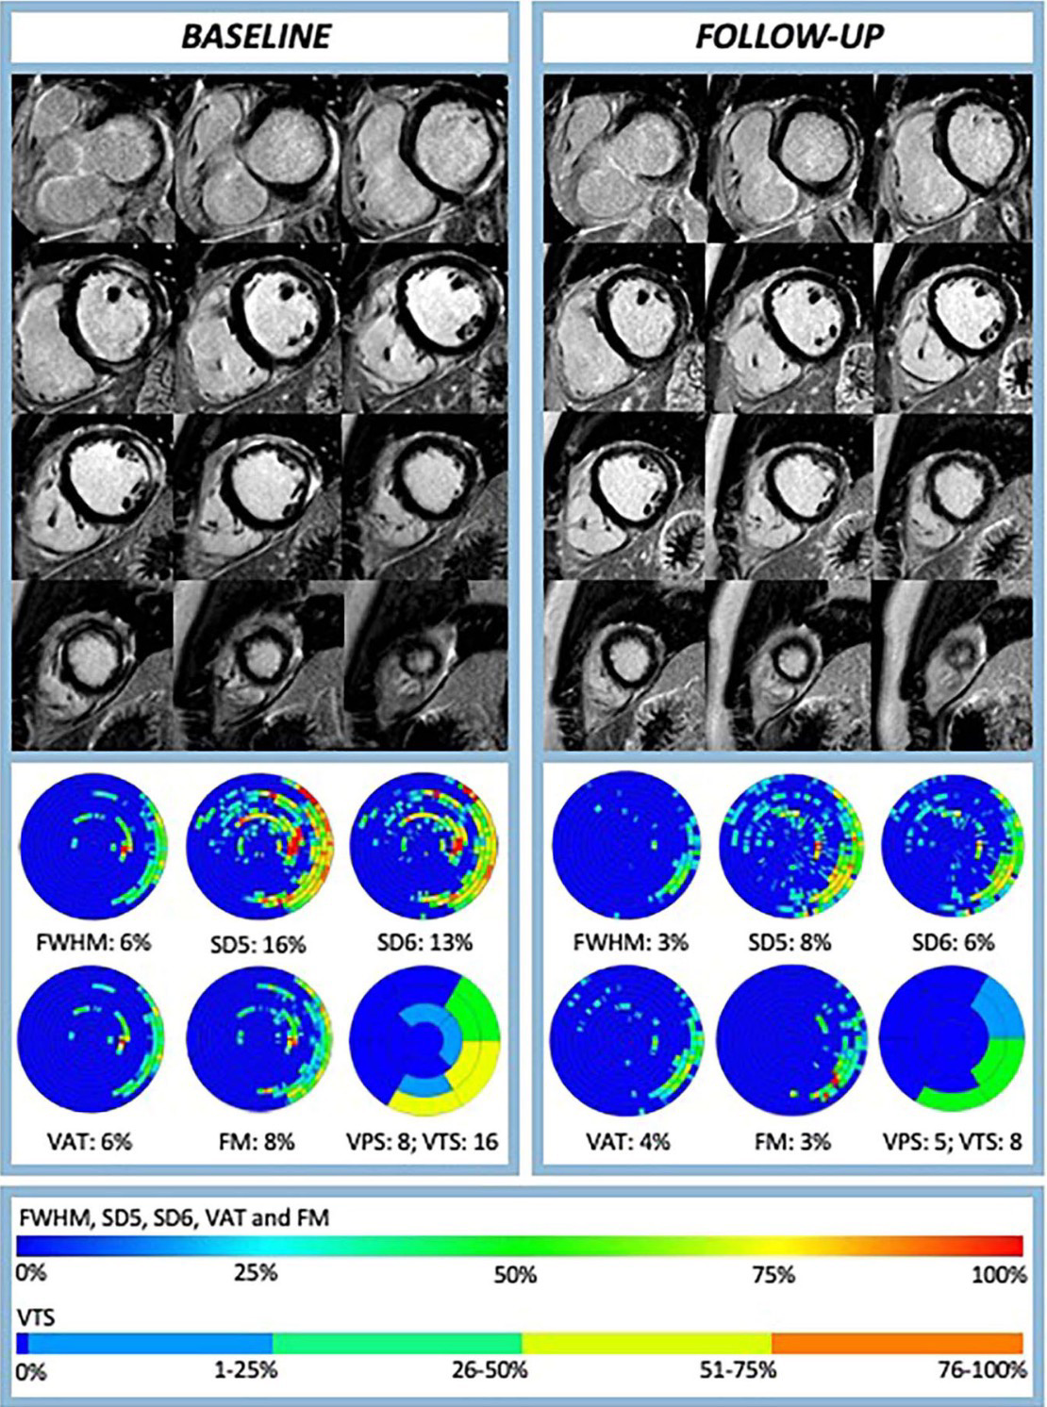
Myocariditis okozta fibrózis monitorozása MR segítségével

Slide 7
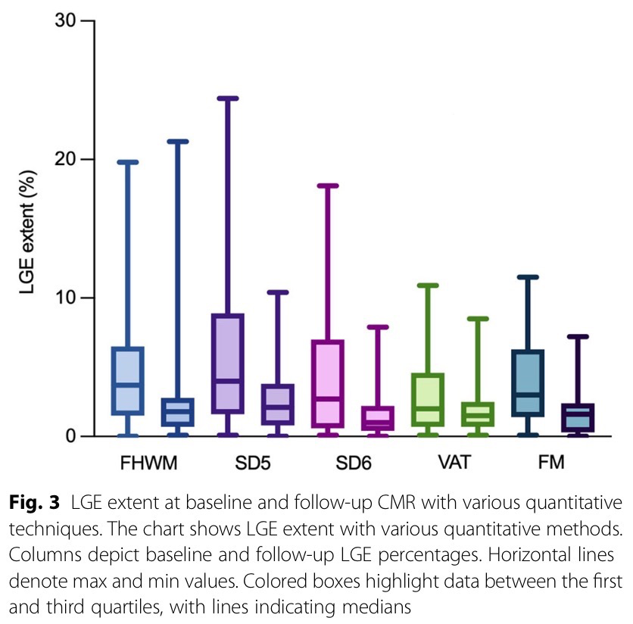
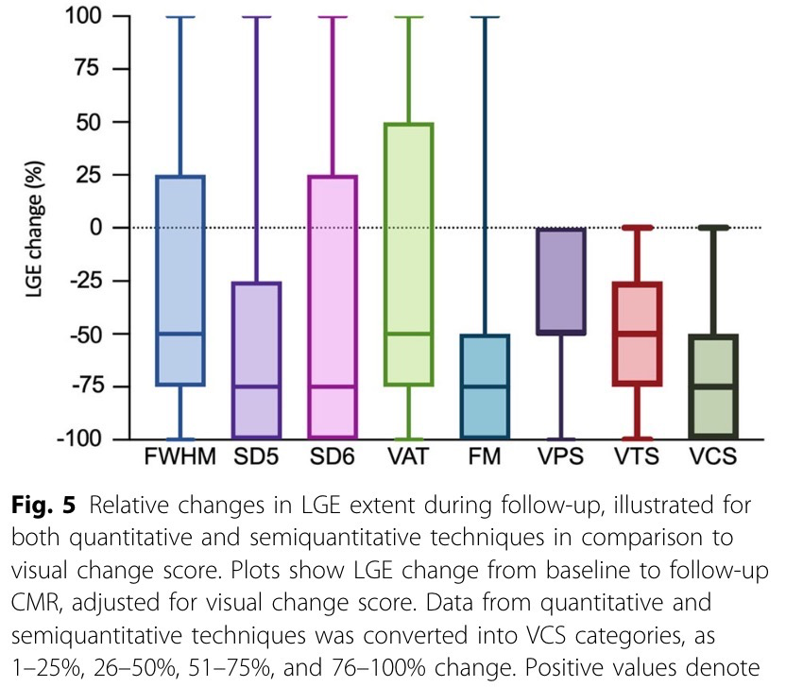
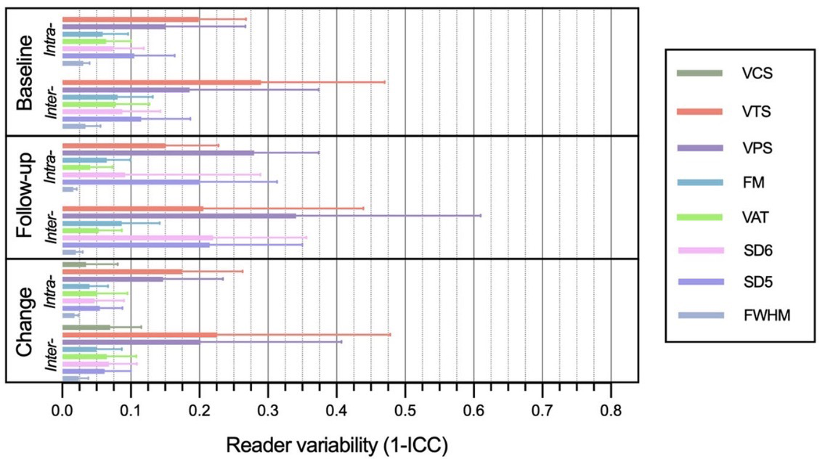
Myocariditis okozta fibrózis monitorozása MR segítségével

Slide 8
Coronary Plaque Radiomic Phenotypes Predict Fatal or Non-fatal Myocardial Infarction Analysis of the SCOT-HEART Trial

Slide 9
Coronaria plakk AI alapú karakterizálás
Objectives
To assess whether more detailed plaque morphology assessment using patient-based radiomic characterization could further enhance the identification of patients at risk of myocardial infarction during long-term follow-up.
Methods
Coronary plaque segmentations were used to calculate plaque burdens and eigen radiomic features which described plaque morphology. Univariable and multivariable Cox proportional hazard models were used to evaluate the association between clinical and image-based features and fatal or non-fatal myocardial infarction.

Slide 10
Coronaria plakk AI alapú karakterizálás

Slide 11
Coronaria plakk AI alapú karakterizálás

Slide 12
KÖSZÖNÖM A FIGYELMET!

