Slide 1
ÓE | 2023

Slide 6
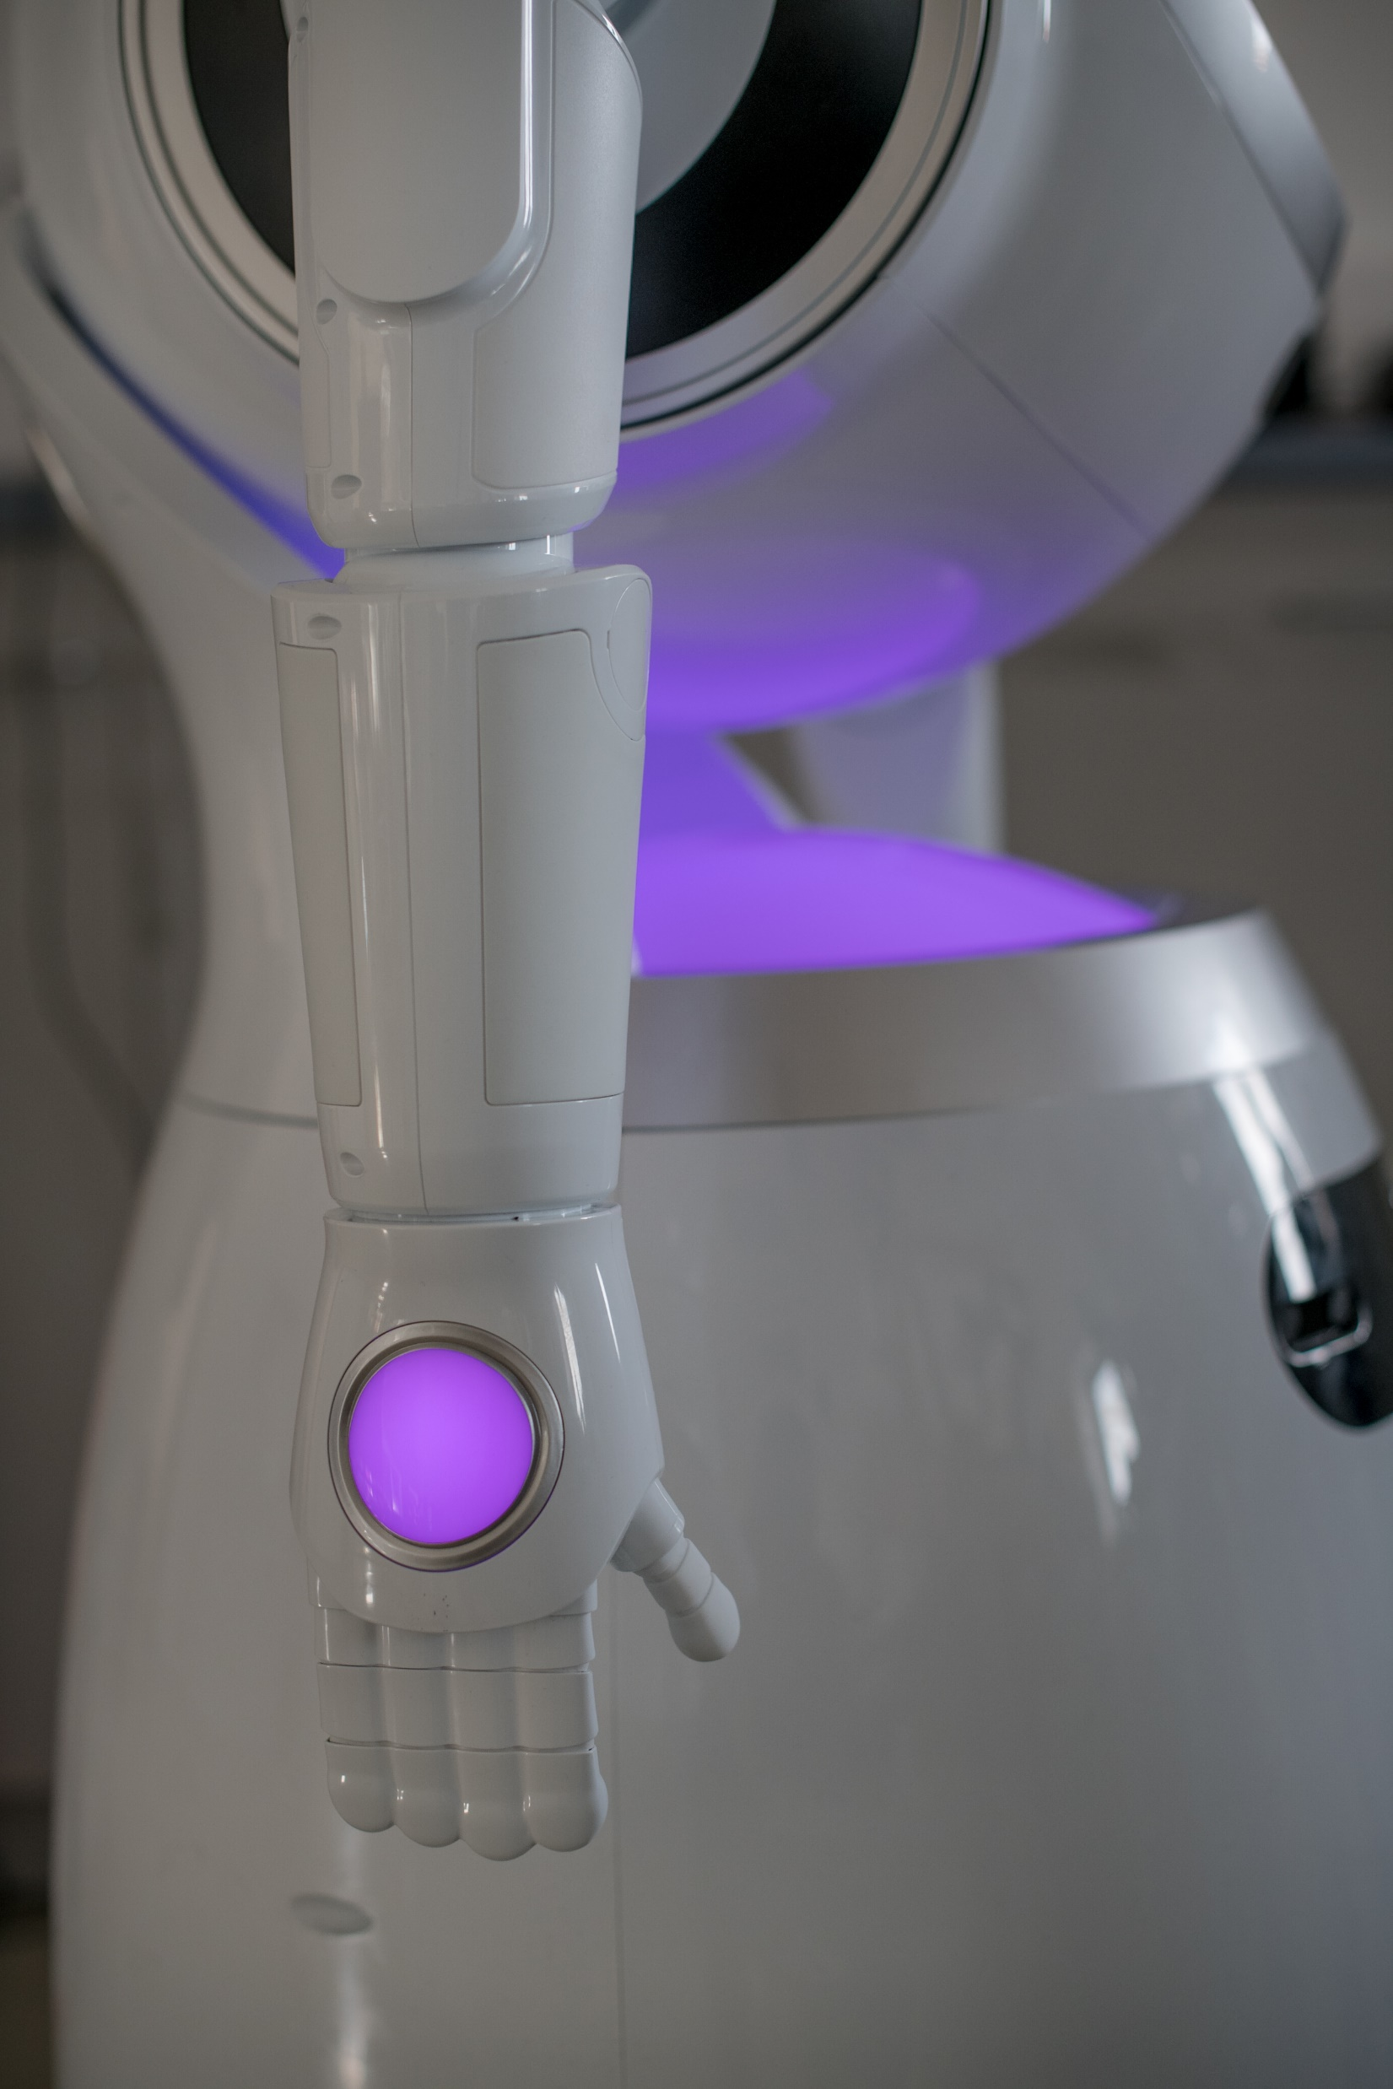
Strategy 2022 – 2025 Three objectives
We offer advanced and competetive engineering education — throughout life
We develop technologies for sustainable change
We assume leadership of the opportunities offered by digitalization

Slide 8
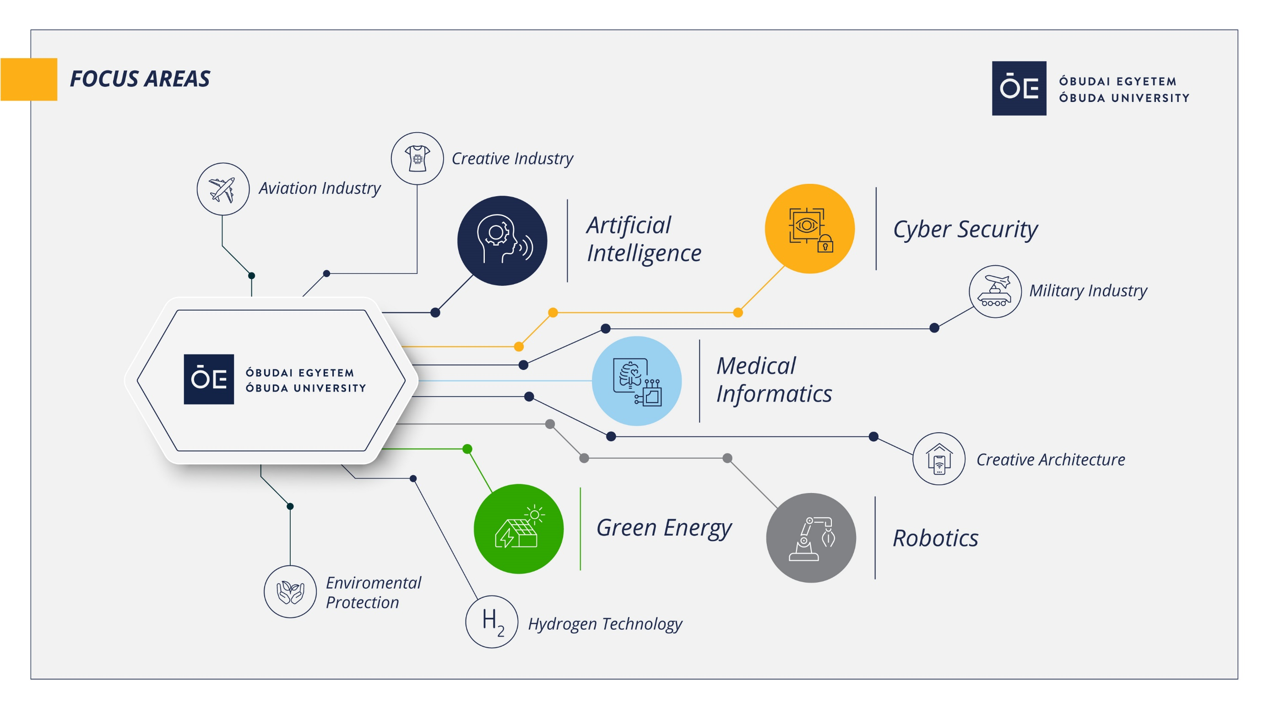

Slide 10
Research

Slide 14
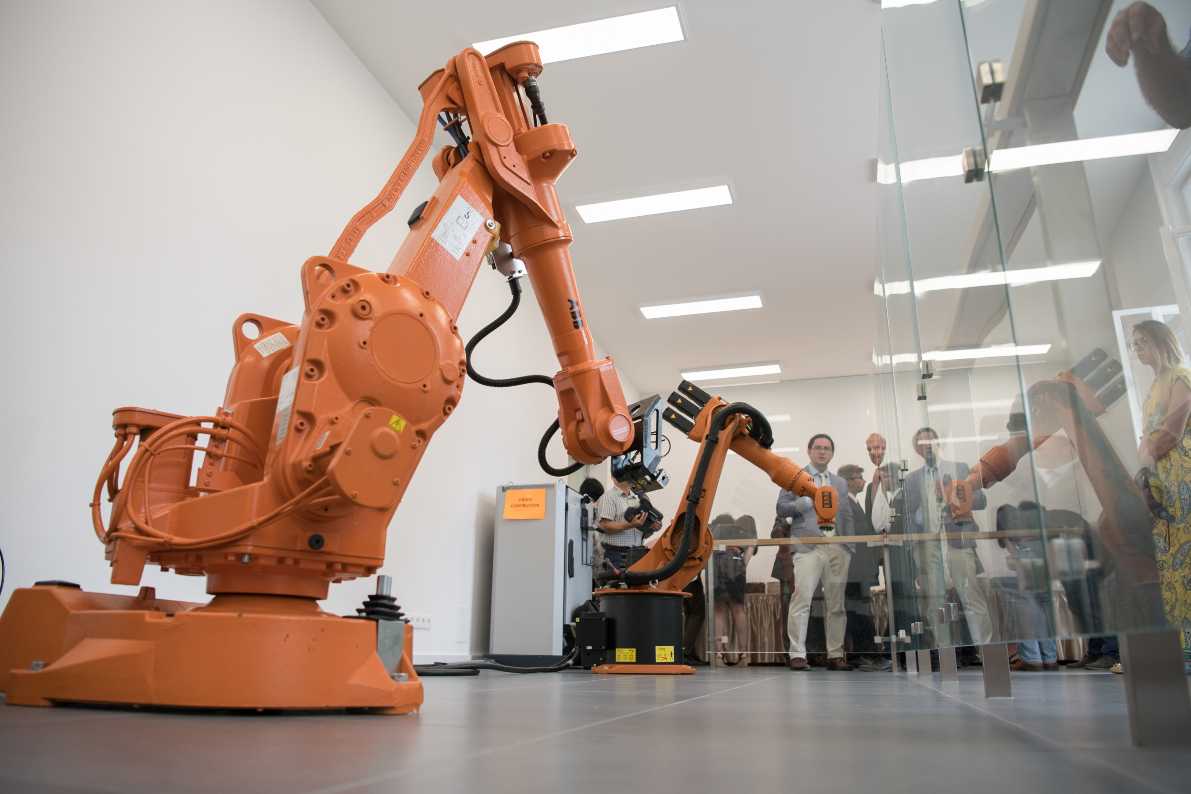
Research
facilities

Slide 20
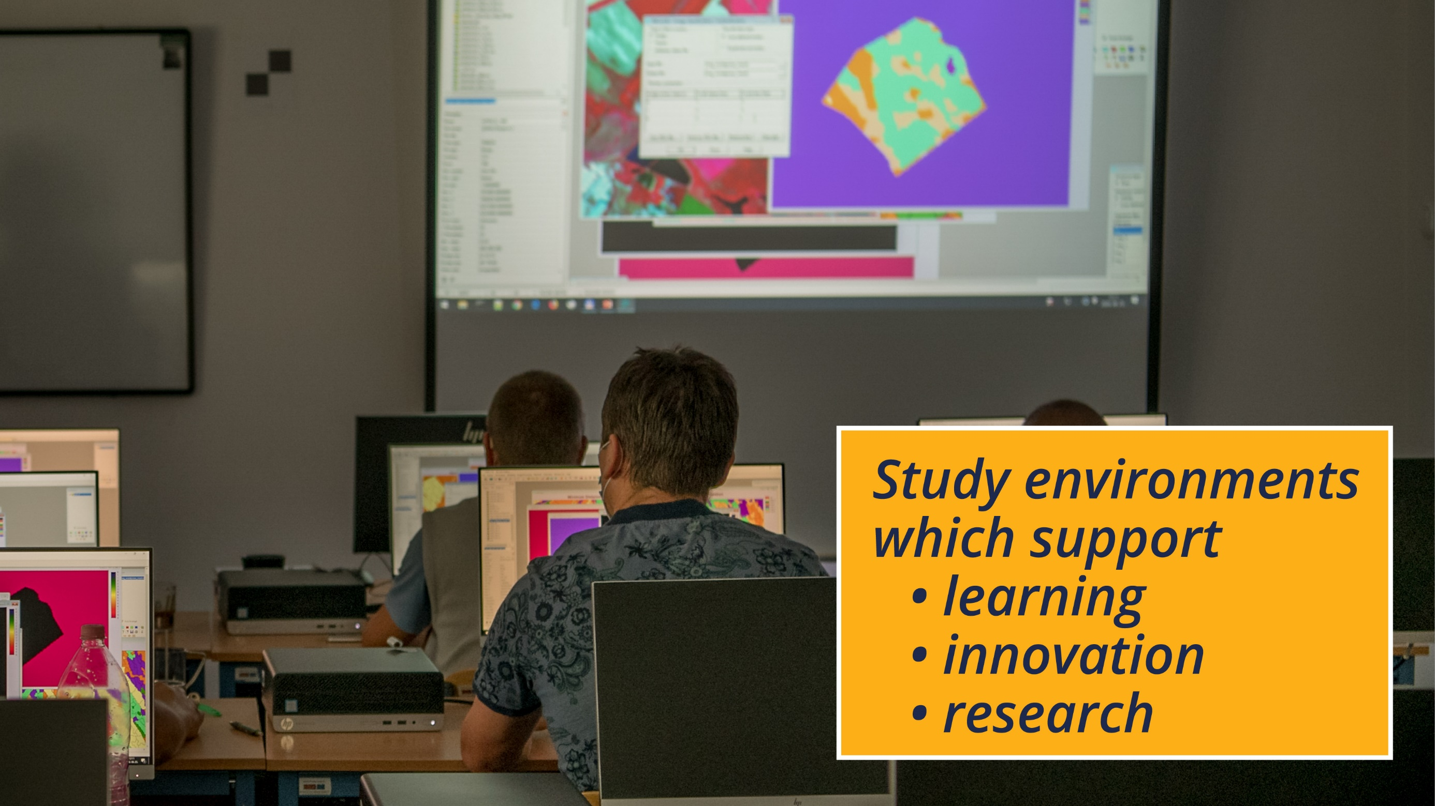

Slide 24
